Slide 1

Journey to Modernization
Notes:
Welcome, hello and thank you for your time. Here to day to discuss the cost savings on the journey with Redhat.

Slide 2
Why are we here?
High level analysis was carried out with provided information
High expectations of cost reduction in ICT investments are expected
Re-Use as much as possible
It needs to be secure
Notes:
High level analysis was carried out with limited information -

Slide 3

Is IT?
Notes:
We know what we know but also we know what we don’t know

Slide 4
AS-IS Workload Breakdown
The workload analysis shows a 70/11/6/12 easy/medium/hard/unsupported distribution out of the existing 18,000 VM
Factor | Easy | Medium | Hard | Not Supported
Operating System | 12,690 | 2,025 | 1,125 | 2,160
Storage Size (TB) | 1,200 | - | 900 | -
Easy (70%)
Medium (11%)
Hard (7%)
Unspported (12%)
70% of VMs are sized as easy to migrate
11% of VMs are medium complexity migration concern (e.g. EOL of RHEL 7)
6% of VMs are running non-RHEL distros (Ubuntu), and will need to be further evaluation
12% of VMs are not supported OCP-V, due to operating system EOL (windows 2003) or have not been certified by their respective vendor
It is not recommended to move Oracle RAC to OCP-V, and will need to be further evaluation

Slide 5
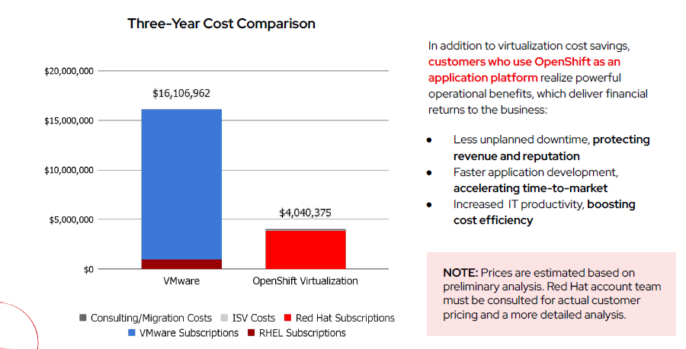
Estimate TCO
Notes:
Possible savings – license tax, hardware reuse

Slide 6

Actually it is all good, but it can be GREAT.
Some UNKNOWNS…..
Current Host Infrastructure – ESXi, 254 hosts
Current Network Infrastructure – Cisco Nexus
Current Storage Infrastructure – External Dell Storage with VSAN
AND WE need to ask the ORACLE……
Notes:
Potentially aged hardware, possible constraints, reuse – need for temp hardware or new hardware but full scope, partial to start the process and the reuse over phases. Network we don’t know the roadmap internally for upgrade from Nexus to alternative platform – recommendation Cisco integrated OS, Local storage use is potentially VSAN – need an alternative in hyperconverged – portworx – 3 tier expansion to accommodate local storage option – ORACLE…..backup and recovery process – what is place and is it compatible…

Slide 7


Proposed High Level Design
Advanced Cluster for Management
Advanced Cluster for Security
Production
DR
Master Nodes
Master Nodes
Worker Nodes
Worker Nodes
Active/Passive
Persistent Volumes (PVC)
Persistent Volumes (PVC)

Slide 8
Migration Estimate Assumptions
All platform security approvals will be completed during VMA.
Initial migration targets a balanced mix of easy and medium workloads.
Migration aligned with approved 'standard change' windows (Minimum 4 hours/day allocated for live migrations).
At least 60% of VMs support back-out by reactivating source VMs (with acceptable data loss risk).
Automated ESXi to OpenShift Conversion: In-place, Ansible-driven ESXi host recommissioning.
No disk encryption or shared disks used – simplifying migration.
VMs are balanced across ESXi hosts to support load optimization.
Legacy OS (e.g., Windows 2003, Solaris) may require special handling or migration tools.
Dedicated service account available per vCenter for streamlined access.
Target platform: Red Hat OpenShift Virtualization on bare metal only (no containers).
No NSX or software-defined networking in use.
Key applications in scope: Oracle RAC, AD, OpenShift AI.

